Slide 2
Value for Money
DRC Global MEAL Team/Melis and Tanaka
June, Niamey

Slide 3
Session Aims
Provide a definition of Value for Money
Discuss key considerations that partners should consider when applying Value for Money analysis in programmes
Identify how Value for Money is applicable within your respective activities

Slide 4
Quick Question-Mentimeter
How familiar are you with the Value for Money framework ?
If you had to use one word to describe Value for Money, what would it be ?

Slide 5
Value for Money
There are different ways in which the framework can be understood, at its core
“Maximiser l’impact de chaque livre/dépensee dans un programme pour améliorer la vie des communats affectées pour et avec lesquelles nous travaillons”
Within our sector, we stress a specific emphasis on ensuring that the impact of specific interventions reaching those most in need, can support in our values.
Notes:
Based on the feedback that is provided from colleagues within the room, there is the option to use some of the keywords to help structure the definition. “Maximise the impact of every pound/krone spent in a programme to improve the lives of the affected communities we work for and with” – the importance of ensuring that it is the impact of the funding that we receive that in turn that can help to further demonstrate our value.

Slide 6
Value for Money pillars
Economy | Efficiency | Effectiveness | Equity
Are we buying inputs of the appropriate quality at the right price ? (Quantitative) | How well are we converting inputs into outputs ? (Quantitative) | How well are the outputs produced having the intended effect ? (Qualitative) | How fairly are the benefits distributed ? To what extent will we reach marginalized groups? (Qualitative)
Example: Cost per item | Example: Cost per household served | Example: Cost per life saved | Example % of people reached who were female
Logframe equivalent: Inputs | Logframe equivalent: Outputs | Logframe equivalent: Outcome | Logframe equivalent: AGDM
Notes:
The best way to reflect upon the extent to which the Value for Money can be framed through is by looking at the different elements that shape how Value for Money is measured. In the case of the different pillars that have been identified as key elements, they are through the 4 E’s framework.* At this point, discuss the different elements and the indicators that it relates to

Slide 7
Value for Money at DRC Uganda pilot
The aim of the analysis: To see how efficient the programme was in accordance with the ECHO guidelines on the “Cost Transfer Ratio”
ECHO funded programme, DRC lead organisation, partners: Lutheran World Federation, Ugandan Red Cross Society.
Cash Transfer Programme reaching 49,000 people across 5 settlements 2020-2021
Notes:
Website link: https://reliefweb.int/report/uganda/uganda-cash-consortium-value-money-analysis-may-2021-june-2022
An example of where DRC has undertaken Value for Money analysis has been with the Uganda Cash Consortium, funded by ECHO. The aim of the analysis was to understand the most efficient ways in which we could lead in a consortium and to review how certain roles and responsibilities within the consortium contributing to ensuring that those who were most in need were sufficiently reached.

Slide 8
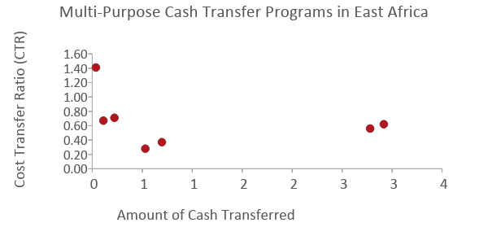
Overall Cost Transfer Ratio (€0.62) is in line with other cash programs in East Africa implemented by NGOs.
CTR=€0.62 translates to:
TCTR=€1.62
Cash : non-cash transfer costs = 62%:38%
1: Somalia
2: Somalia
3: Yemen
4: Yemen
5: Somalia
6: Ethiopia
Notes:
In the DG ECHO review for cash programs, the UN had the lowest average TCTR at 1.31, while NGOs had an average TCTR of 2.01. This translates to a cash:non-transfer costs ratio of 76%:24% for the UN, or 50%:50% for NGOs. At 62%:38%, the Uganda Cash Consortium is performing better than the average for NGOs found in the ECHO review, and contains all program costs – direct, indirect, and shared. Unless NGOs are implementing cash programs at the scale of UN agencies (above €10M), their full value for money potential may not be realized.

Slide 9
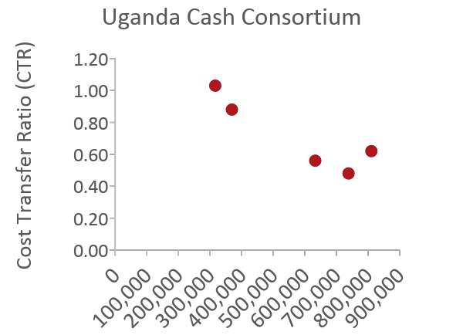
Partner LWF could achieve as high VfM as DRC due to sufficient budget and capacity to reach high scale.
 | 1 | 2 | 3 | 4 | 5
Settlement | Imvepi | Kyaka | Rhino Camp | Nakivale | Kyangwali
Region | West Nile | Southwest | West Nile | Southwest | Southwest
People | 6,113 people (1,528 HHs) | 6,113 people (1,528 HHs) | 12,225 people (3,056 HHs) | 12,225 people (3,056 HHs) | 12,489 people (3,122 HHs)
Amount of Cash | €316,382 | €369,080 | €632,794 | €738,159 | €810,422
MEB per Person | UGX 30K (€6) | UGX 35K (€8) | UGX 30K (€6) | UGX 35K (€8) | UGX 35K (€8)
CTR | €1.03 | €0.88 | €0.56 | €0.48 | €0.62
Notes:
By having sufficient budget to transfer the most cash to the most people in Kyangwali, LWF as a partner was able to achieve their value for money potential. Any future partners who is not able to reach this coverage will likely not be able to achieve high value for money.

Slide 10
Delivery costs are driven by preparations for distribution and the multiple distribution rounds.
Lighter touch verification could reduce costs, if overall needs are high and targeting error is acceptable.
Pre-Distribution Assessments
Preparations for Distribution
FSP Transfer Fees
Grant Management
12% | 9% | 10% | 22% | 15% | 8% | 11% | 13%
Coordination, Meetings
Financial literacy training, feedback mechanism
Distributions
Post-Distribution M&E
Multi-month instead of monthly transfers could reduce costs, if appropriate.
Sensitization to digital modalities, which are cheaper, more private, and COVID-safe.
Notes:
Preparations for distribution include community mobilization, registration, verification, and trainings. The costs are mostly for personnel, incentive workers, vehicles, and motorcycles.
Distributions includes distribution rounds and financial payments. The costs are mostly for personnel, incentive workers, vehicles, and motorcycles. Given that Cash on Wheels would incur more costs for staff time, vehicles, and fuel to facilitate the distributions, Agency Banking and Mobile Money modalities would reduce the costs for DRC.
Distributions: In this program, 8 rounds of cash are provided within a period of 12 months, so it is not surprising that the cost of distributions is relatively high. From past implementing experience, recipient households only started to “establish” themselves within the settlements after 4 rounds of cash transfers and could more consistently meet their non-food needs without resorting to negative coping strategies. Therefore, this program designed 8 rounds of cash to ensure that the vulnerability of clients can be improved effectively. (Any past evidence or just anecdotal?)
Distributions: One way to improve efficiency would be to transfer cash every 2 months instead of every month. During targeting and verification, clients could be asked what their preference is. That said, past evaluations have found that clients preferred monthly transfers to multi-month transfers so that their cashflow is more stable.
Transfer fees: Of the overall €0.62 CTR, transfer fees constitute €0.05 (or about 8% of the non-cash costs). Different modalities incur different transfer fees: Agency Banking incurs the lowest cost per household, followed by Mobile Money, followed by Cash on Wheels. In the extreme hypothetical scenario where all households are receiving cash only through one modality, we estimate that Agency Banking would be cheaper than Mobile Money for the overall project by €15K, and Mobile Money would in turn be cheaper than Cash on Wheels by another €15K. With recent improvements on infrastructure, coverage, and regulatory concerns about Agency Banking and Mobile Money in the settlements within Uganda, as well as ongoing financial literacy training by URCS, we expect more households to be receptive to digital modalities moving forward.
Financial literacy training are costs required to sensitize households to digital cash modalities, which are cheaper, more private, more secure, and more COVID-safe.

Slide 11
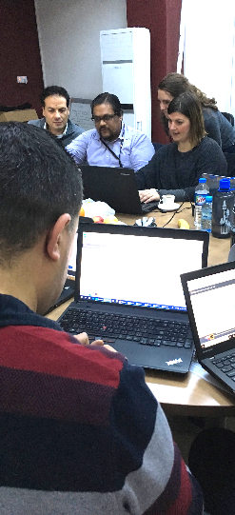
An online tool for program staff to quickly & consistently calculate cost per output.
1
2
3
4
5
6
7
Define Analysis
Load Data
Assign Sectors and Categories
Confirm Categories
Set Contribution
Allocate Costs
View Insights
© The IRC
Notes:
One of the resources used, also as illustrated by the organisations listed and those in the room there is cross organisation effort to better understand.

Slide 12
Merci

