Slide 2
IATI Reporting Requirements
Melis and Tanaka

Slide 3
Session Aims
Develop a common understanding of what IATI is
Review and comprehend FCDO IATI reporting guidelines
Discuss how to report sensitive data

Slide 4
What is IATI?
IATI : The International Aid Transparency Initiative
Internationally recognized common data standard framework (project, finance and results data)
Primary focus is to coordinate humanitarian and development activities through common data standard
Open data standard
Notes:
Melis

Slide 5
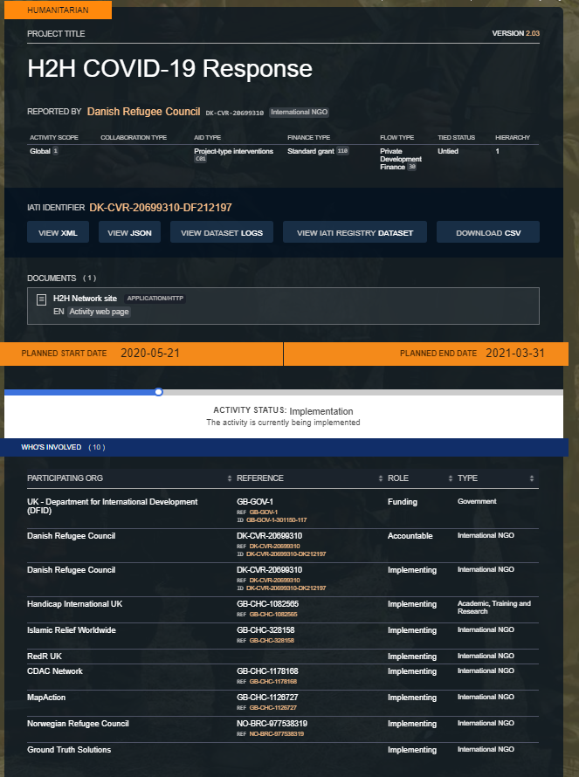
IATI Data Ecosystem
Notes:
Aid Stream is the most common entry point for IATI data to be published- when looking at DFID’s IATI Aid Transparency Commitments we will look at what are the core fields that are required.
Aid Stream is free for organisations for up to 20 grants/programmes reported after there is a fee
D-portal a visualisation platform for all IATI data (over a million humanitarian and development activities). Which can be filter in relation to the different areas that you are looking for (Country, Sectors, Organisations).
Example on the right of what the data looks like once visualised on dportal

Slide 6
FCDO Requirements
Source: FCDO Accountable Grant Agreement, 2021

Slide 7
Different role responsibilities
Funder
FCDO
Commitment to funded organisation
Disbursement
FCDO IATI identifier: GB-GOV-1-300943-105
Funded organisation
SRF
Incoming commitment from funder
Commitment to implementing partner
Incoming funds
Disbursements
Expenditures
SRF IATI identifier: DK-CVR-20699310-FC264369
Incoming commitment from funded organisation
Incoming funds
Expenditure
NB. No disbursements if they are at the end of the delivery chain or work with very small community-based organisations.
Partner(s) IATI identifier: Pending
Implementing partner
Notes:
Here to mention that the reporting frequency is per quarter line with our quarterly reporting requirements

Slide 8
Sensitive Data Mentimeter

Slide 9
Sensitive Data
Activities that can be considered unacceptable or conflicting with local values by states or societies (human rights, gender, good governance, or commericial information)
Sensitive geographic areas
In such cases, you may adapt your data through showing less details, anonymising the implementing (or the funding) organization, publishing a recipient region rather than a specific location, adapting the descriptions of the activity. Do not publish personal information, such as names of individuals or any identifiable information.
Notes:
Melis

Slide 10
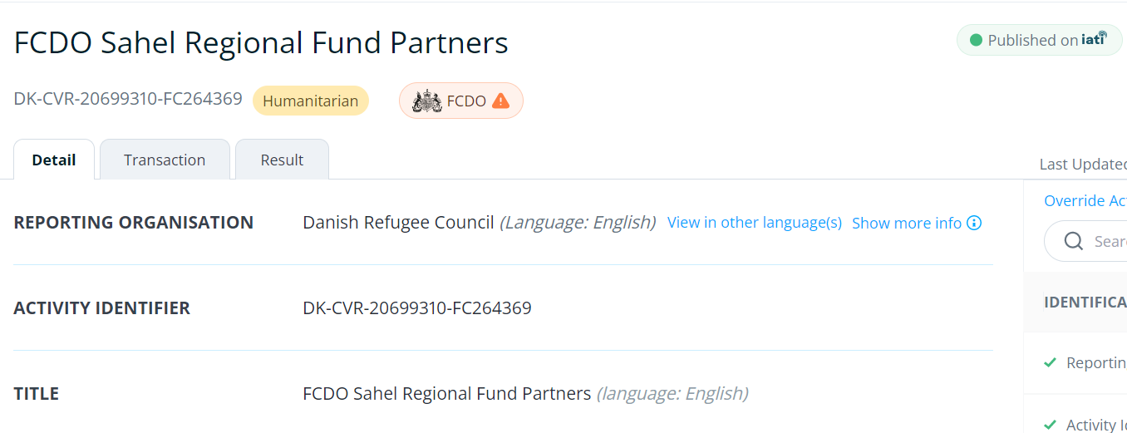
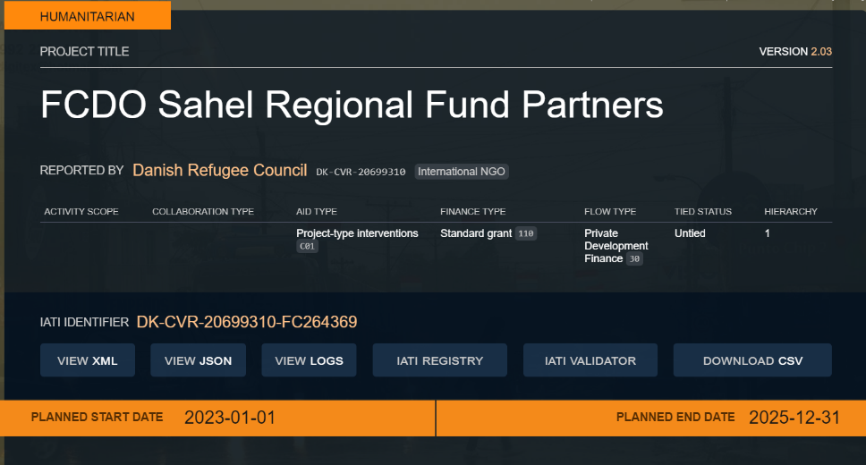
IATI Report
d-portal
FCDO Activity Guidelines (aidstream.org)

Slide 11
Organizational Challenges
Data quality and availability
Publishing frequency
IATI Data Formatting
Following up with donor guidelines

Slide 12
IATI Reporting in summary
It is a reporting requirement that is sharing information about what different organisations do in relation to a specific programme/fund
You can link your data to the organisation you receive funding from or give funding to
IATI covers project and finance information and it is important that those responsible for those functions are aware of the reporting deadlines
If you are unsure of whether the information is sensitive, minimize or redact

Slide 13
Q & A

Slide 14
Useful Links
IATI Official Website
IATI Tools and Resources
Aidstream Website
FCDO IATI Guidelines
d-portal Website
IATI Data Portal
IATI Training on FaboLab
Notes:
Bond IATI data publishing course, a two week online course that allows you to go through all the elements of publishing- if you have not yet begun, there are reflections on how to consider publishing in your organisation- Data needs, Capacity and resource needs, as well as a discussion surrounding what publishing tool works for you. Next iteration is for September 2020.
AidStream Tutorials, there are a series of videos available on YouTube to support publication onto IATI through AidStream the free to use software system that allows for publication. If you have any publishing concerns or queries, you are welcome to contact directly the AidStream support team and also the IATI technical team. AidStream team have a slight delay in their responses as they are based in Nepal, just to be mindful.
IATI Discuss, this is a community page in which people provide updates, post questions, links to webinars within the global IATI community.
If your organisation is a member of Bond, then one of the advantages on offer is to join the Bond IATI group, comprised of colleagues from across the Bond membership- there are also active discussions and examples of best practice available there.

Slide 15
Thanks for your time and active participation!

