Slide 2
Value for Money Optimisation des ressources
L’équipe mondiale de MEAL de DRC /Melis et Tanaka
Juin, Niamey

Slide 3
Objectifs de la session
Fournir une définition de l’optimisation des ressources (VfM)
Discuter des considérations clés que les partenaires devraient prendre en compte lors de l’application de l’analyse de l’optimisation des ressources dans les programmes
Identifier comment l’optimisation des ressources est applicable dans vos activités respectives

Slide 4
Mentimeter

Slide 5
Optimisation des ressources
Il y a différentes façons de comprendre le cadre, à la base
“Maximiser l’impact de chaque Livre (Centime) dépensée dans un programme pour améliorer la vie des populations affectées pour et avec lesquelles nous travaillons”
Dans notre secteur spécifique, nous mettons l’accent sur le fait de veiller à ce que l’impact d’interventions spécifiques atteignent ceux qui en ont le plus besoin, tout en soutenant nos valeurs.
Notes:
Based on the feedback that is provided from colleagues within the room, there is the option to use some of the keywords to help structure the definition. “Maximise the impact of every pound/krone spent in a programme to improve the lives of the affected communities we work for and with” – the importance of ensuring that it is the impact of the funding that we receive that in turn that can help to further demonstrate our value.

Slide 6
Piliers de l’optimisation des ressources
Économie | Efficience | Efficacité | Équité
Achetons-nous des intrants de la qualité appropriée au juste prix ? (Quantitatif) | Dans quelle mesure convertissons-nous les intrants en produits ? (Quantitatif) | Dans quelle mesure les résultats obtenus ont-ils l’effet escompté ? (Qualitatif) | Dans quelle mesure les bénéfices sont-ils répartis équitablement ? Dans quelle mesure atteindrons-nous les groupes marginalisés? (Qualitatif)
Exemple : Coût par article | Exemple : Coût par ménage desservi | Exemple : Coût par vie sauvée | Exemple % de personnes de sexe féminin touchées
Équivalent logframe: Intrants (Inputs) | Equivalent Logframe: Extrants (Outputs) | Equivalent Logframe: Resultats (Outcome) | Equivalent Logframe: AGDM
Notes:
The best way to reflect upon the extent to which the Value for Money can be framed through is by looking at the different elements that shape how Value for Money is measured. In the case of the different pillars that have been identified as key elements, they are through the 4 E’s framework.* At this point, discuss the different elements and the indicators that it relates.

Slide 7
Exemple du LogFrame SRF

Slide 8
Optimisation des ressources – Exemple de l'Uganda
But de l`analyse: voir dans quelle mesure le programme était efficace conformément aux lignes directrices d'ECHO sur le “Rapports coûts-transfert”
Programme financé par ECHO, organisation cheffe de file DRC, partenaires: Fédération luthérienne mondiale, Croix-Rouge ougandaise.
Programme de transferts monétaires touchant 49 000 personnes dans 5 zones d’installation 2020-2021.
Notes:
Website link: https://reliefweb.int/report/uganda/uganda-cash-consortium-value-money-analysis-may-2021-june-2022
An example of where DRC has undertaken Value for Money analysis has been with the Uganda Cash Consortium, funded by ECHO. The aim of the analysis was to understand the most efficient ways in which we could lead in a consortium and to review how certain roles and responsibilities within the consortium contributing to ensuring that those who were most in need were sufficiently reached.

Slide 9
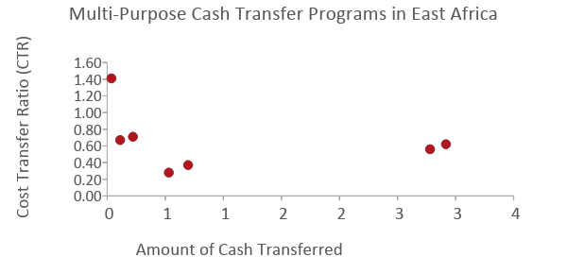
Le ratio global des couts-transferts (€0.62) est conforme à d’autres programmes de transfert monétaires en Afrique de l’Est mis en œuvre par des ONG
CTR=€0.62 se traduit par:
TCTR=€1.62
Transfert monetaires : frais des couts non-monetaires= 62%:38%
1: Somalie
2: Somalie
3: Yemen
4: Yemen
5: Somalie
6: Ethiopie
Notes:
In the DG ECHO review for cash programs, the UN had the lowest average TCTR at 1.31, while NGOs had an average TCTR of 2.01. This translates to a cash:non-transfer costs ratio of 76%:24% for the UN, or 50%:50% for NGOs. At 62%:38%, the Uganda Cash Consortium is performing better than the average for NGOs found in the ECHO review, and contains all program costs – direct, indirect, and shared. Unless NGOs are implementing cash programs at the scale of UN agencies (above €10M), their full value for money potential may not be realized.

Slide 10
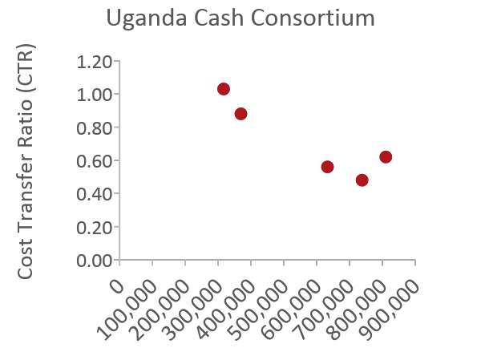
La LWF pourrait atteindre un VfM aussi élevé que DRC en raison d’un budget et d’une capacité suffisants pour atteindre une échelle élevée.
 | 1 | 2 | 3 | 4 | 5
Settlement | Imvepi | Kyaka | Rhino Camp | Nakivale | Kyangwali
Region | West Nile | Southwest | West Nile | Southwest | Southwest
People | 6,113 people (1,528 HHs) | 6,113 people (1,528 HHs) | 12,225 people (3,056 HHs) | 12,225 people (3,056 HHs) | 12,489 people (3,122 HHs)
Amount of Cash | €316,382 | €369,080 | €632,794 | €738,159 | €810,422
MEB per Person | UGX 30K (€6) | UGX 35K (€8) | UGX 30K (€6) | UGX 35K (€8) | UGX 35K (€8)
CTR | €1.03 | €0.88 | €0.56 | €0.48 | €0.62
Notes:
By having sufficient budget to transfer the most cash to the most people in Kyangwali, LWF as a partner was able to achieve their value for money potential. Any future partners who is not able to reach this coverage will likely not be able to achieve high value for money.

Slide 11
Les coûts de livraison sont déterminés par les préparatifs de distribution et les multiples tournées de distribution.
Une vérification pratique plus légère pourrait réduire les coûts, si les besoins globaux sont élevés et que l’erreur de ciblage est acceptable.
Évaluations préalables à la distribution
Préparatifs pour la distribution
Frais de transfert FSP
Gestion des subventions
12% | 9% | 10% | 22% | 15% | 8% | 11% | 13%
Coordination, Réunions
Formation en compétence financière, mécanisme de rétroaction
Distributions
Post-Distribution S&E
Des transferts pluriannuels au lieu de transferts mensuels pourraient réduire les coûts, le cas échéant.
Sensibilisation aux modalités numériques, qui sont moins coûteuses, plus confidentielles et sûres pour COVID.
Notes:
Preparations for distribution include community mobilization, registration, verification, and trainings. The costs are mostly for personnel, incentive workers, vehicles, and motorcycles.
Distributions includes distribution rounds and financial payments. The costs are mostly for personnel, incentive workers, vehicles, and motorcycles. Given that Cash on Wheels would incur more costs for staff time, vehicles, and fuel to facilitate the distributions, Agency Banking and Mobile Money modalities would reduce the costs for DRC.
Distributions: In this program, 8 rounds of cash are provided within a period of 12 months, so it is not surprising that the cost of distributions is relatively high. From past implementing experience, recipient households only started to “establish” themselves within the settlements after 4 rounds of cash transfers and could more consistently meet their non-food needs without resorting to negative coping strategies. Therefore, this program designed 8 rounds of cash to ensure that the vulnerability of clients can be improved effectively. (Any past evidence or just anecdotal?)
Distributions: One way to improve efficiency would be to transfer cash every 2 months instead of every month. During targeting and verification, clients could be asked what their preference is. That said, past evaluations have found that clients preferred monthly transfers to multi-month transfers so that their cashflow is more stable.
Transfer fees: Of the overall €0.62 CTR, transfer fees constitute €0.05 (or about 8% of the non-cash costs). Different modalities incur different transfer fees: Agency Banking incurs the lowest cost per household, followed by Mobile Money, followed by Cash on Wheels. In the extreme hypothetical scenario where all households are receiving cash only through one modality, we estimate that Agency Banking would be cheaper than Mobile Money for the overall project by €15K, and Mobile Money would in turn be cheaper than Cash on Wheels by another €15K. With recent improvements on infrastructure, coverage, and regulatory concerns about Agency Banking and Mobile Money in the settlements within Uganda, as well as ongoing financial literacy training by URCS, we expect more households to be receptive to digital modalities moving forward.
Financial literacy training are costs required to sensitize households to digital cash modalities, which are cheaper, more private, more secure, and more COVID-safe.

Slide 12
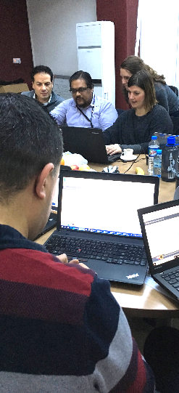
Un outil en ligne permettant au personnel du programme de calculer rapidement et systématiquement le coût par extrant (output).
1
2
3
4
5
6
7
Définir
l´Analyse
Charger les données
Attribuer des secteurs et des catégories
Confirmer les Categories
Fixer la Contribution
Répartir les coûts
Voir les informations
© The IRC

Slide 13
Merci

