Slide 1
Lucian Lee Senior Advisor, Systematic Cost Analysis International Rescue Committee (IRC) (he/him/his) Lucian.Lee@rescue.org

Slide 2
Reaching more HHs can spread distribution costs across more people.
National NGOs can serve the hardest to reach but must be funded at the same scale as INGOs to achieve VfM potential.
In Nigeria, the INGO had more funding than LNGOs to procure more comprehensive NFI kits and serve more households, resulting in higher efficiency.
Hygiene Kit Distribution in Nigeria
NGO Type | National | National | International
Households | 520 | 1,000 | 2,500
Efficiency | €2.00 per euro value distributed | €1.20 per euro value distributed | €0.33 per euro value distributed

Slide 3
Group Session: Identify a common activity per sector for cost analysis.
1. Each consortium will write their activities in each sector in their consortium color post-its.
2. Discuss what are the common activities in each sector that achieve the same outcomes for both consortia.
Food Security & Livelihoods | Protection
Health | Nutrition
Activity Name
Activity Name
Activity Name
Activity Name
Activity Name
Activity Name
Activity Name
Activity Name
Activity Name
Activity Name
Activity Name
Activity Name
Activity Name
Activity Name
Activity Name
Activity Name
Activity Name
Activity Name
Activity Name
Activity Name
Activity Name
Activity Name
Activity Name
Activity Name
Activity Name
Activity Name
Activity Name
Activity Name
Activity Name
Activity Name
Activity Name
Activity Name

Slide 4
Dioptra Tool
Notes:
https://www.dioptratool.org/videos

Slide 5
How an Activity is funded
Grant: ABC123
Value for Money: The amount spent in each activity should be proportional to its nature & results.
Malnutrition: 100 children
Primary Health Care: 500 people
Vocational: 50 people
Business Skills: 1,000 people
Direct Project Costs (“Program”)
Sector: Health
Sector: Economic Recovery
Activity: Malnutrition Treatment
Activity: Vocational Training
Activity: Primary Health Care
Activity: Business Skills Training
Direct Shared Costs (“Support”)
Indirect Costs (ICR)

Slide 6
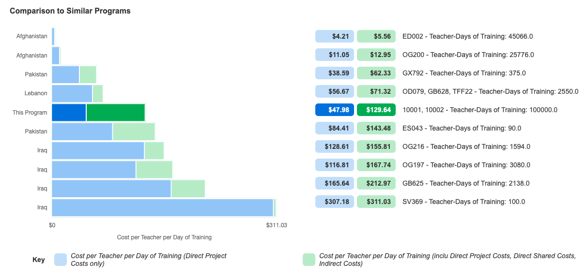
What is the average cost to produce this output?
How would a different modality or reach affect this activity’s cost-efficiency?
Why are the costs for this activity different in different countries or projects? (e.g. context, design -- what can we learn from them?)
Are there other ways to achieve similar outcomes (at lower cost)?

Slide 7
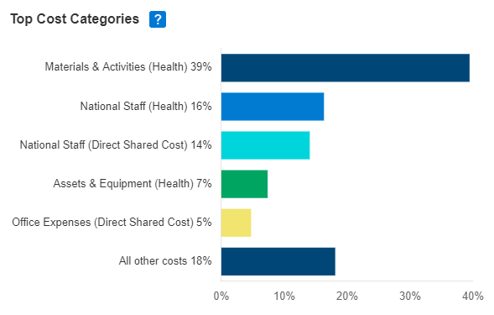
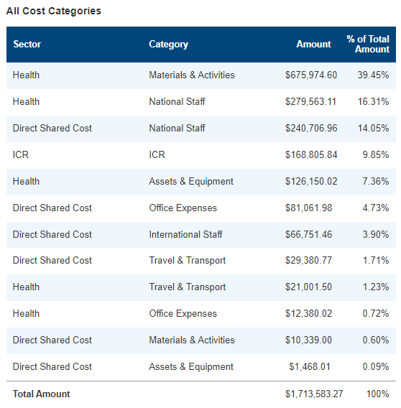
Is there potential for cost savings to channel back to clients?
Do the proportion of these cost categories look reasonable? Are any important categories relatively neglected?
Why are some categories larger than others? What do they contain? Do they bring more value to clients?

Slide 8
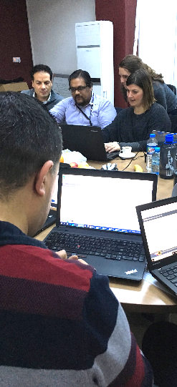
An online tool for program staff to quickly & consistently calculate cost per output.
1
2
3
4
5
6
7
Define Analysis
Load Data
Assign Sectors and Categories
Confirm Categories
Set Contribution
Allocate Costs
View Insights
© The IRC

Slide 9
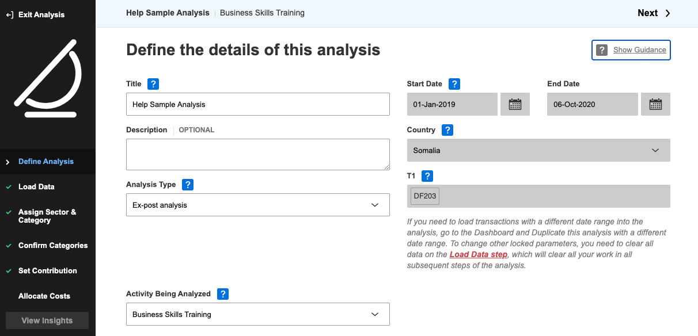
1

Slide 10
1. Define Analysis
Activity Being Analyzed
If you cannot find your activity in the list, select “Generic Program”.
Start Date and End Date
These should be defined to be in line with the window of finance data and monitoring data you are using! Example: we shouldn’t consider the program start to be April if our spending data starts in August.
If we are analyzing finance data from 01-Jan-2018 to 31-Dec-2018, make sure that the monitoring data corresponds to the same period.

Slide 11
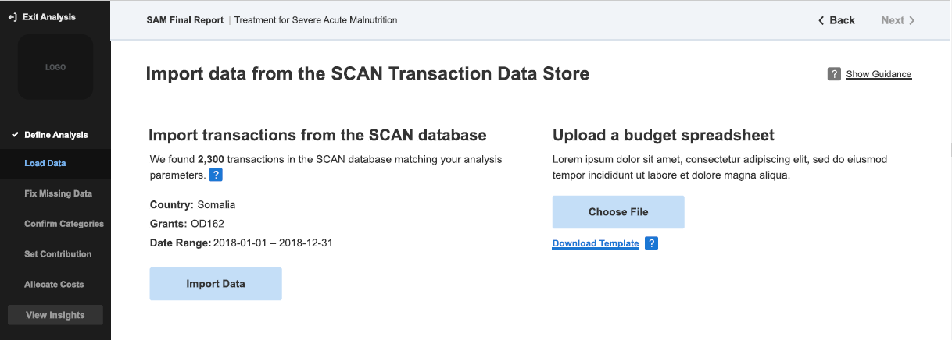
2

Slide 12
2. Load Data
If you analyze actual spending data, then Dioptra will automatically pull available financial transactions that match those dates and grant codes.
Check that the number of transactions seems reasonable.
If you analyze budget projection data, there would be no transactions in your finance system and so you would upload data from a spreadsheet.
You can prepare a spreadsheet and paste budget line data in it. Use the Dioptra template.
Paste all data as values!
Check that all rows are filled (no blanks).
Check that all rows are accurate (the total amount is correct).

Slide 13
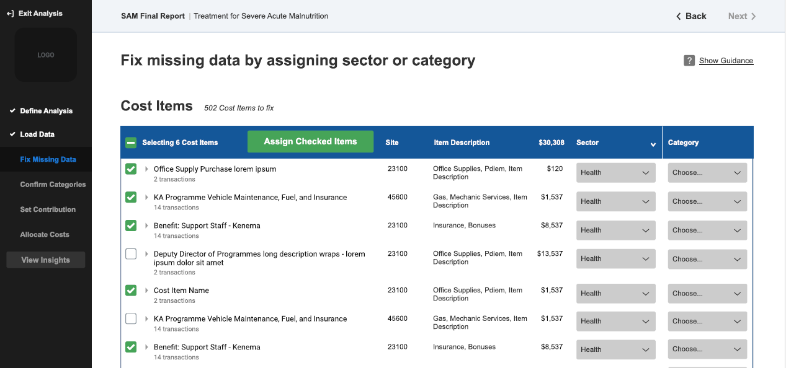
3
Assign sector and category to cost items

Slide 14
3. Assign Sector & Category
Cost Categories: International Staff, National Staff, Travel & Transport, Assets & Equipment, Office Expenses, Materials & Activities. Include benefits in staffing costs.
Cost Types:
Direct Project Costs (“Program”)
Direct Shared Costs (“Support”): Costs that are linked to program activities that cannot be easily related to specific projects or sectors. These costs are shared among all projects in a specific office, usually (but not always) for the running and management of operations.
ICR: Indirect Costs that support HQ operations and overall management.

Slide 15
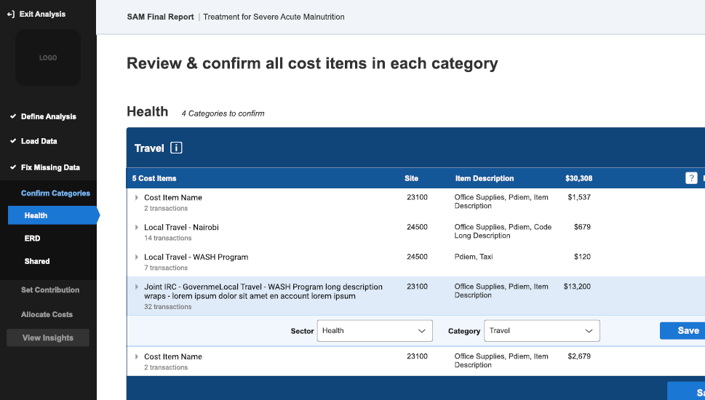
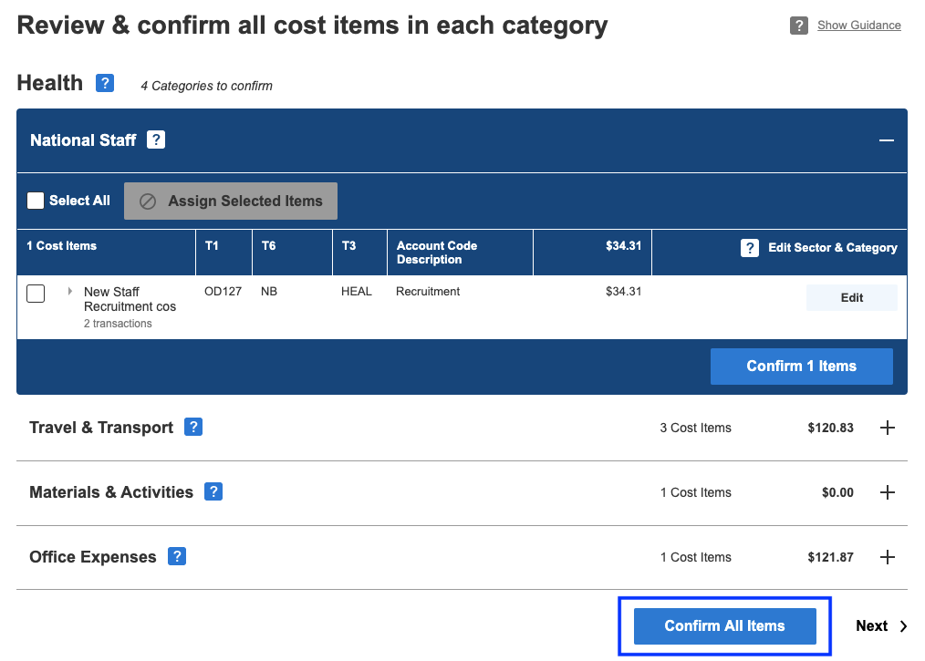
4

Slide 16
4. Confirm Categories
Dioptra automatically assigns your data into Sectors and Categories based on finance codes.
Because there can be coding errors in financial data, Dioptra reminds you which items are included in which Sector and Category.
Please review the list and click Confirm for each Category, if you are satisfied. Click Edit to make any changes if necessary.

Slide 17
Categorizing Costs
Cost types:
Direct Project Costs (“Program”): Sectoral costs that are only closely linked to program activities that can be related to one or some specific projects, e.g. Health staff salary, WASH supplies.
Direct Shared Costs (“Support”): Costs that are linked to program activities but that cannot be easily related to specific projects or thematic areas. These costs are shared among all projects in a specific office, usually (but not always) for the running and management of operations, e.g. HR, Finance, office rent, utilities, generator, audit. Different NGOs might define this slightly differently—this is fine, as long as the full costs are included.
Indirect Costs: Costs that support HQ operations and management, e.g. Indirect Cost Recovery (ICR).
Cost categories: International Staff, National Staff, Non-Staff Personnel, Travel & Transport, Materials & Activities, Assets & Equipment, Office Expenses.

Slide 18
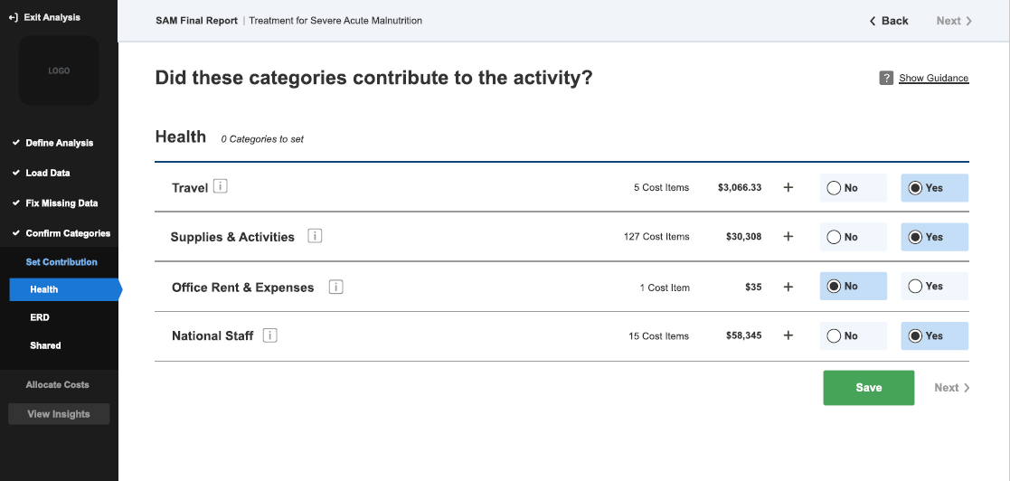
5

Slide 19
5. Set Contribution
Thanks to your diligent categorization in the previous steps, this step allows you to select only the relevant Sectors and Categories to the activity being analyzed.
In subsequent steps, you no longer need to deal with Sectors or Categories that are not relevant to the activity being analyzed.
Tip: Remember to click Save before proceeding to the next Sector.

Slide 20
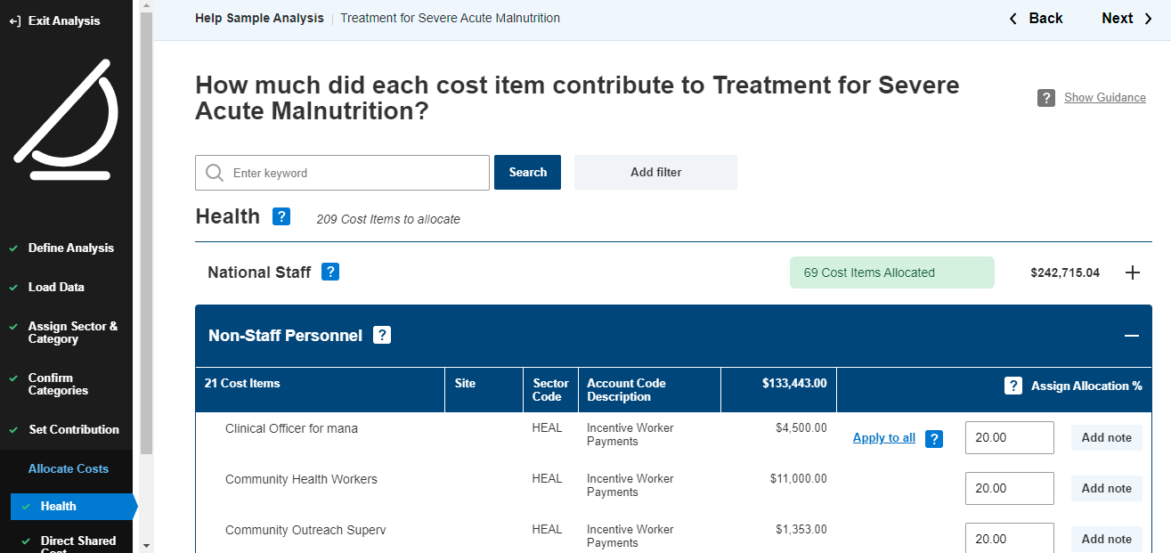
6

Slide 21
6. Allocate Costs
The nature of humanitarian funding is such that INGOs often get funding for multiple activities (often across multiple sectors) within one grant.
This step allows you to indicate how much (%) of a particular budget line that supports multiple activities contributes to the activity being analyzed. This is often the most time-intensive piece of the analysis. Consider:
What is the dollar value of funding for each activity in this sector?
How many clients were served by each activity? Is any other monitoring data useful to us here?
For particular positions or items, you can make different allocations if a particular person/item spent a disproportionate amount of their time on one sector or activity.

Slide 22
6. Allocate Costs
Is this data a bit rough? Absolutely! But we are generating rough estimates of the cost for specific activities. The only way to get better estimates is through intensive time and effort systems that track resources spent per activity. For Dioptra, small differences (5% vs 8%) won’t skew our results enough to affect the lessons we can learn.
Dioptra will calculate a suggested percentage for Direct Shared Costs and Indirect Costs (ICR) -- go ahead and use the suggested percentages unless you have good reason to change them.
Tip: The blue “Apply to all” hyperlink allows you to apply the value you entered in the first line to the entire category.
Tip: Remember to click Save before proceeding to the next category.

Slide 23
6. Allocate Costs
Consider how that particular cost item was used for different activities in that project. Here are some suggestions on how to estimate its contribution to the activity being analyzed:
Number of clients for that activity / total number of clients in the project
Number of staff for that activity / total number of staff in the project
Amount (units or dollars) of materials procured for that activity / total amount of materials procured in the project
Amount of time spent on that activity by the staff member / total amount of time spent on the project by the staff member

Slide 24
Allocating Percentages
What % of each budget line charged to this grant was used for [activity being analyzed] in comparison to the other activities in this grant?
E.g. Out of the Health Officer’s salary amount that was charged to this grant, how much time did they work on [activity being analyzed], compared to the other activities they also worked on in this grant?
Health Officer’s salary = $10,000
$8,000 paid by this grant
$8,000 paid by this grant
10% time spent on [this activity]
90% time spent on other activities in this grant
$2,000 paid by other grants

Slide 25
Percentage of Direct Shared Costs
What % of Direct Shared Costs in this grant was supporting [activity being analyzed] in comparison to the other activities in this grant?
$4,500*20% = $900
$11,000*20% = $2,200
$1,353*20% = $271
Sum = All Direct Project Costs of Grant
Sum = Direct Project Costs of Activity

Slide 26
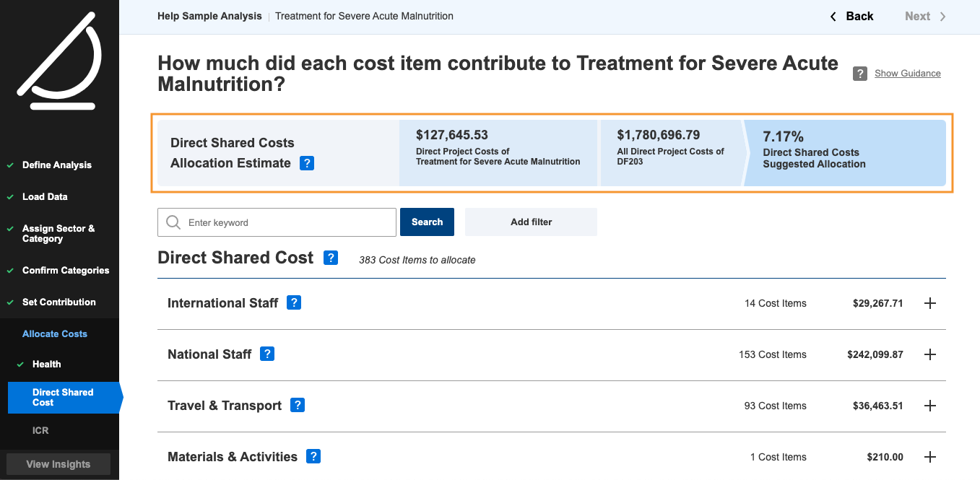
6
Standard formula allocates shared costs

Slide 27
Your Turn: Hands On Exercises

Slide 28
Activity to analyze: Vocational Training in Ouallam
Country: Niger
Grant Code: ABC123
Implementation Period: 01 January 2018 to 31 December 2020
Number of People: 100
Cost-Efficiency Metric: Cost per Person
Other Activities in this project:
Business Skills Training (Ouallam)
Malnutrition Treatment (Diffa)
Primary Health Care (Diffa)

Slide 29
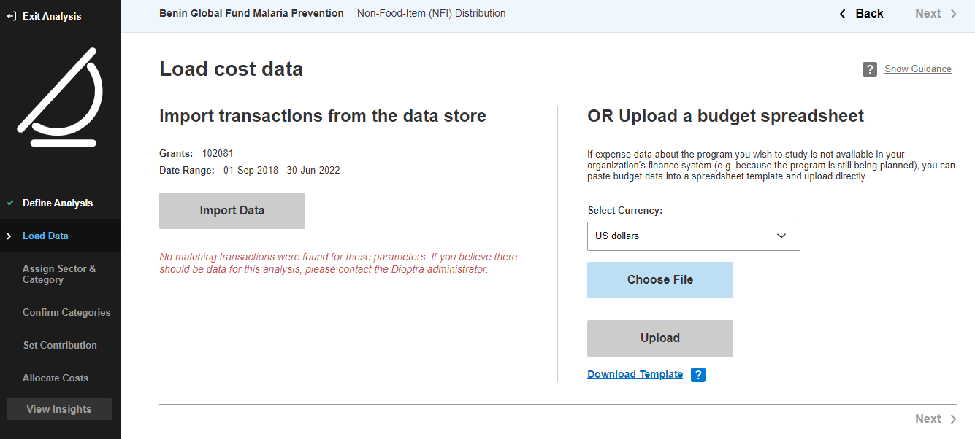
YouTube Video
Exercise: Create an Upload Spreadsheet
Paste all data as values!
Check that all rows are filled (no blanks).
Check that all rows are accurate (the total amount is correct).
Notes:
https://www.dioptratool.org/help-videos/step-2-load-data

Slide 30
Scenarios:
Cost items that fully contributed to the intervention being analyzed only
Cost items that were not used for the intervention
Cost items that contributed to various interventions
Number of clients for that intervention / total number of clients in the project
Number of staff for that intervention / total number of staff in the project
Amount (units or dollars) of materials procured for that intervention / total amount of materials procured in the project
Amount of time spent on that intervention by the staff member / total amount of time spent on the project by the staff member
YouTube Video
Notes:
https://www.dioptratool.org/help-videos/step-6-allocate-costs-to-activities

Slide 31
As stewards of limited funds, we have a responsibility to make the most positive change in the lives of the most people in need.
We can make better decisions on which activity to implement and how to implement it, based on equity, client needs, effectiveness, efficiency, quality.

